Slide 1



ProcessPro Partners
Presented by:
Patel, Rutvi Manishbhai– Project Manager
Abraham, Sruthi – Team Lead
Arora, Prachi– Business Analyst
Sandra Marya, Sandra Marya – Business Analyst
Varahabhatla Karthik Venkata, Rama Murthy – Business Analyst
9th December 2024

Slide 2

Table Of Contents
ProcessPro Partners – Company Overview
New Idea: Acquisition of WiTricity By TD
Project Scope And Project Charter
Business and Solution Requirements
AS-IS Flow
Possible Solution Options and Evaluation Criteria
Selected Solution Recommendations
News Board
Conclusion
COA
References

Slide 3

Processpro Partners – Company Overview
To provide creative and data-driven solutions that increase stakeholder value and streamline corporate operations.
MISSION
Established in 2005.
Headquartered in Toronto, Canada.
Trusted global consulting leader.
Efficient Process. Efficient Solutions.
To become known as a premier consulting firm that enables businesses to attain operational excellence and sustainable growth.
VISION
Key Strengths:
Comprehensive expertise in management, technology, and analytics.
Client-centric approach with tailored solutions.
Innovative use of the latest advancements in consulting practices.
Collaborative culture promoting learning and adaptability.
Core Values:
Integrity
Innovation
Collaboration
CORE VALUES

Slide 4

Our Leadership Team
Jane Richardson (CEO): Strategic visionary leading the firm's growth.
Mark Anders (COO): Operational expert ensuring flawless project execution.
Priya Desai (CFO): Financial strategist driving fiscal efficiency.
Lucas Tan (CSO): Architect of transformative strategies for clients.

Slide 5
Our Services & Our Achievements
Business Process Optimisation: Streamlining operations for efficiency.
Strategic Planning & Decision Support: Guiding organisations in achieving their goals.
Project Management: Ensuring timely, budget-conscious project execution.
Data Analytics & Insights: Turning data into actionable strategies.
Revenue Growth: 15% CAGR over the last three years.
Client Retention: 90%, showcasing trusted partnerships.
Diverse Industry Expertise: Healthcare, manufacturing, technology, and financial services.
Recognitions: Featured in leading industry publications for excellence in consulting.

Slide 6

Case 1: Digital Transformation for AVL Manufacturing
Challenges: Irregular inventory levels and delayed order fulfillment.
Solutions: Implemented predictive analytics and Lean principles.
Outcomes: 20% reduction in lead times and improved customer loyalty.
Case 2: Operational Excellence for Lululemon Retail
Challenges: Inventory control and inconsistent customer service.
Solutions: Automated systems and standardised protocols.
Outcomes: 15% increase in customer satisfaction and cost savings.
Success Stories – Transforming Challenges into Opportunities

Slide 7



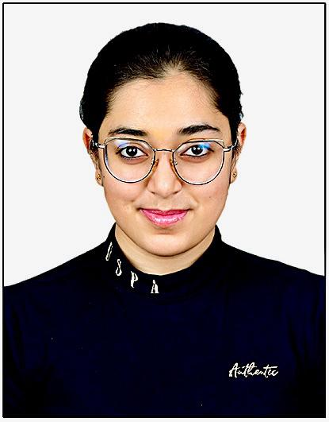
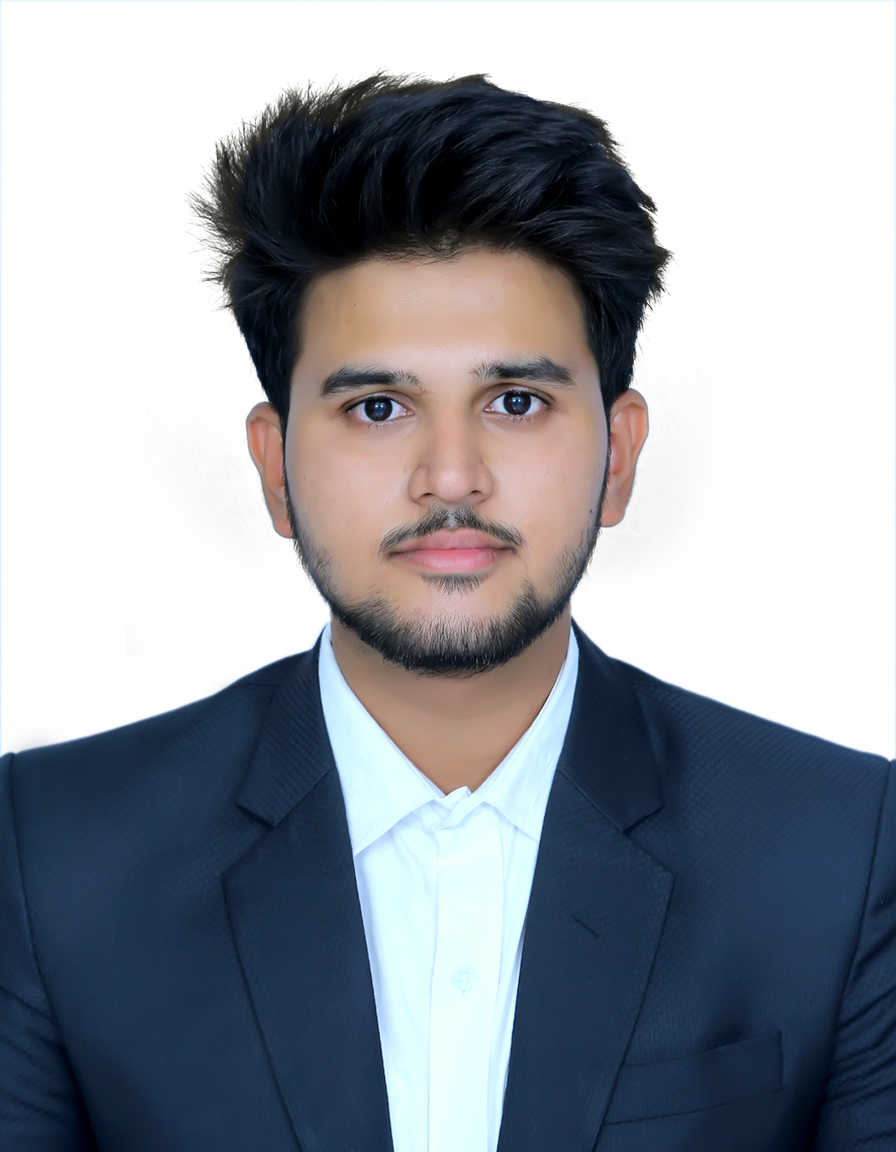
Rutvi Patel
Project Manager
MEET OUR TEAM
Sruthi Abraham
Team Lead
Sandra Marya
Business Analyst
Rama Murthy
Business Analyst
Prachi Arora
Business Analyst

Slide 8
Roles And Responsibilities
RUTVI MANISHBHAI PATEL – PROJECT MANAGER
Leads the entire management of the project, ensuring tasks are completed smoothly.
Proactively checks in with team members, identifies challenges, and provides assistance as needed.
Acts as the point of contact for emerging concerns, resolving issues swiftly to maintain project schedule.
SRUTHI ABRAHAM – TEAM LEADER
Responsible for task management and team coordination.
Tracks task completion, ensuring deadlines are met, and resolves bottlenecks that arise.
Plays a key role in ensuring the team's efficiency and timely delivery of outcomes.
SANDRA MARYA – BUSINESS ANALYST
PRACHI ARORA – BUSINESS ANALYST
RAMA MURTHY VARAHABHATLA KARTHIK VENKATA – BUSINESS ANALYST
Conducts research on assigned areas related to the TD Bank and WiTricity purchase process
Evaluates costs, predicted revenues, and performs cost-benefit analysis for the project.
Gathers insights on technological, operational, and financial factors to identify obstacles and opportunities.

Slide 9






SWOT Analysis
Weaknesses
North American Reliance.
Limited global footprint
Resource challenges in global expansion.
Revenue dependence on a few key clients.
Strengths
Highly skilled team
Global presence
Innovative, client-focused solutions.
Strong leadership driving strategic success.
Proven track record of high-impact results.
Opportunities
Rising demand for consulting
Adoption of cutting-edge technologies
Eco-friendly solutions and green technologies.
Threats
Intense competition
Economic fluctuations affecting client budgets.
Regulatory risks

Slide 10

ACQUISITION OF WITRICITY BY TD BANK

Slide 11
Key Features:
Seamless Experience: Charge by parking over a charging pad—no physical connectors needed.
High Efficiency: Fast, reliable, and efficient charging without wear and tear.
Sustainable: Eco-friendly and supports TD Bank’s commitment to clean energy.
Easy Integration: Can be easily integrated into existing EV infrastructure.
Business Impact:
Revenue Growth: New revenue streams through partnerships and product sales.
Brand Leadership: Positions TD Bank as an innovator in sustainable mobility.
Expansion: Opportunities in North America and international markets as EV adoption grows.
Strategic Alignment:
Supports TD Bank’s sustainability goals and expansion in the electric vehicle market
Supports Long-term Sustainability
Acquisition Of Witricity By TD Bank

Slide 12
Project Scope
Objectives
Acquire and integrate WiTricity's wireless power transfer technology to expand TD’s product offerings.
Enhance TD’s competitive edge and drive innovation in sustainable energy solutions.
Support TD’s long-term environmental goals and attract new customer segments.
Deliverables
Comprehensive Due Diligence Report
Finalised Acquisition Agreement
Technology Transfer and Integration Plan
Training Programs for Staff
Marketing and Communication Strategy
Constraints
Budget
Timeline
Resource Availability
Regulatory Compliance

Slide 13
Project Charter
Project Title: TD Bank’s Acquisition of WiTricity
Sponsor: TD Bank Senior Leadership, Phillip Brand
Project Manager: Rutvi Manishbhai Patel
Team Members: Includes Project Team Leader and a team of Business Analysts.
Timeline: 12 Month Duration
Key Milestones
Project initiation | January 2025
Due Diligence Completion | March 2025
Acquisition agreement finalisation | April 2025
Regulatory approval required | Mid-May 2025
Funding Secured | End-May 2025
Stakeholder communication plan finalised | June 2025
Post-Acquisition Integration start | July 2025
Employee onboarding and transition | August 2025
Technology and system integration | October 2025
Public announcement and marketing campaign | November 2025

Slide 14
Project Charter (Conti..)
Exit Criteria
Successful Conditions | Failure Conditions
Completion of acquisition and transfer of assets. | WiTricity is not convinced with the acquisition.
Regulatory approvals obtained. | Regulatory hurdles.
Launch of EV-related products. | Market downturn or significant operational challenges.
Full integration of WiTricity’s operations into TD Bank’s systems and processes. | Stakeholder withdrawal of support.
Key Stakeholders
TD Bank Executive Team
WiTricity Leadership
Regulatory Authorities
Customers
Government Entities
Technology Integration Partners

Slide 15
Business and Solution Requirements
Solution Requirements
Technology Integration
Risk Management
Regulatory Compliance
Talent and Training
Partnerships and Ecosystem Development
Business Requirements
Market Expansion
Innovation and Differentiation
Brand Alignment
Revenue Diversification

Slide 16
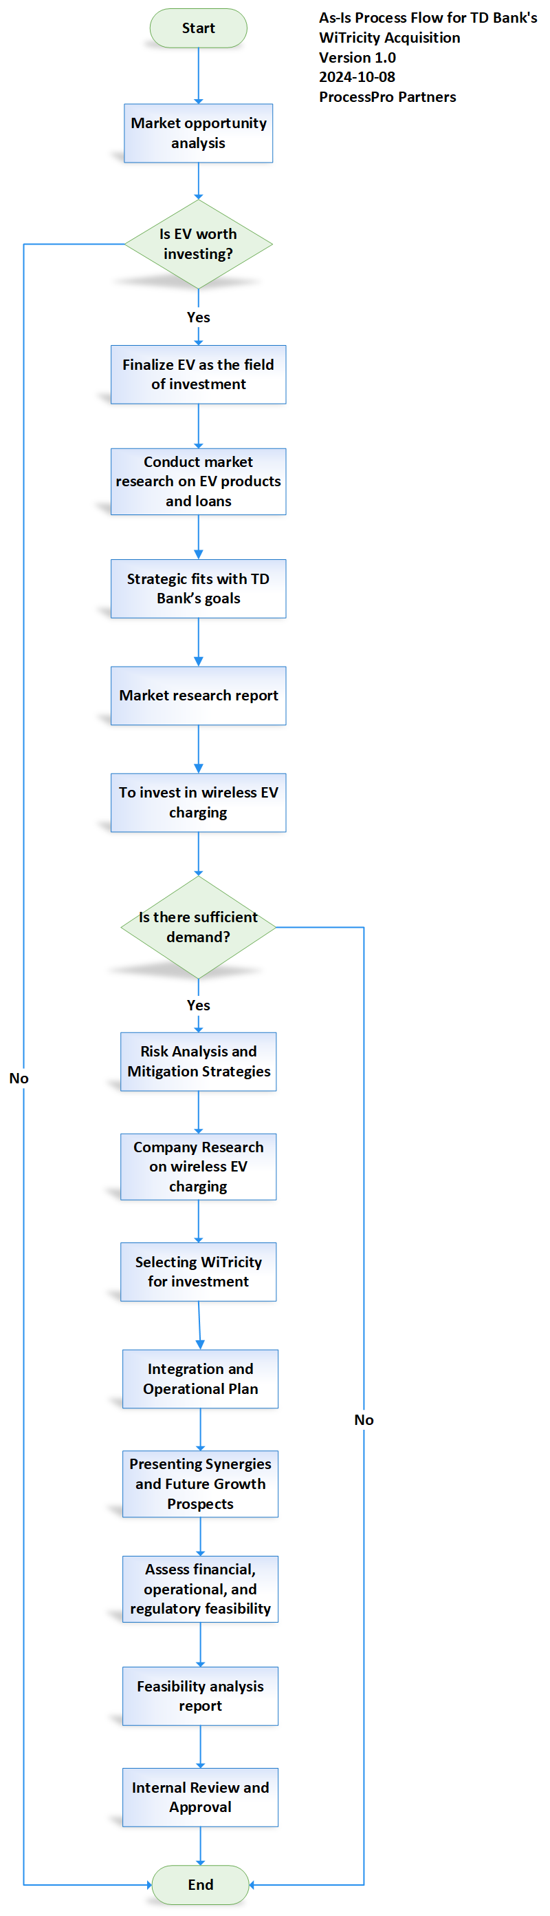
AS-IS Flow

Slide 17

Solution 1: Product Implementation of WiTricity’s Wireless Charging Technology
Focus: Integrating WiTricity's wireless power transfer technology into TD’s offerings.
Application Areas: Electric vehicles (EVs), IoT devices and smart cities.
Benefits: Enhances TD’s innovation profile, aligns with sustainability goals and creates new revenue streams.

Slide 18

Solution 2: Space Sector Financial Products
Focus: Expanding into financing for the space economy.
Application Areas: Supporting companies in satellite development, space exploration and related technologies.
Benefits: Positions TD as a leader in emerging industries and diversifies its portfolio.

Slide 19

Solution 3: TD’s Logistics Leap with TForce Acquisition
Focus: Expanding logistics capabilities through the acquisition of TForce.
Application Areas: Improving supply chain efficiency and exploring synergies in logistics finance.
Benefits: Strengthens operational capabilities and complements existing services.

Slide 20
Solution 4: Do-Nothing Option
Focus: Assessing risks and opportunity costs of inaction.
Application Areas: Retaining the status quo without investments.
Drawbacks: Potential loss of competitive advantage and market share in key growth areas.

Slide 21
Evaluation Criteria
Strategic Fit
•Aligns with TD’s mission for innovation and sustainability.
Financial Viability
•Target ROI of 15% within 3 years from wireless power solutions.
Operational Feasibility
•Seamless integration planned within 12 months.
Customer Impact
•Enhances customer experience with innovative wireless EV solutions.
Sustainability Goals
•Supports Net Zero commitments through green energy initiatives.
Risk Management
•Mitigates integration challenges with detailed planning.

Slide 22




Risks and Mitigations
Integration challenges between WiTricity and TD Bank’s systems.
Supply chain inefficiencies delaying scaling.
Delays in obtaining permits and licenses.
Low customer adoption due to lack of awareness.
Mitigation: Conduct phased integration with rigorous testing.
Mitigation: Audit supply chains and establish reliable supplier partnerships.
Mitigation: Start the permitting process early with regulatory communication.
Mitigation: Launch educational campaigns showcasing benefits.

Slide 23
Risks and Mitigations (Cont...)
High initial investment with uncertain ROI.
Mitigation: Pilot programs to validate assumptions and include contingency reserves.
Customer dissatisfaction due to system failures.
Mitigation: Pre-launch testing and robust customer support systems.
Data breaches targeting customer payment information.
Mitigation: Implement advanced encryption and conduct regular vulnerability assessments.

Slide 24
Test Strategy for WiTricity Integration
Scope
Ensure seamless integration of WiTricity’s technology into TD systems.
Focus on functionality, performance, security, and compliance.
Testing Methodology
Functional Testing: Validate power transfer and system compatibility.
Non-Functional Testing: Assess scalability, security, and usability.
Integration Testing: Ensure seamless workflows with existing systems.
Compliance Testing: Validate adherence to regulations and standards.

Slide 25
Test Strategy (Conti…)
Testing Environment
Development, staging and production-like setups.
Utilise automated tools for performance and security testing.
Risk Mitigation
Phased rollouts to minimise disruptions.
Regular security audits and user feedback collection.
Release Criteria
Zero high-severity defects.
Approval from stakeholders for deployment.

Slide 26
Implementation Strategy
STAGE 01
STAGE 02
STAGE 03
Integration Phase(6-12 Months)
Pre-Acquisition (0-3 Months)
Acquisition Planning (3-6 Months)
Conduct detailed due assessments like financial, legal and operational
Define strategic goals
Address risks: regulatory, market adoption,
Success metric: Approval from stakeholders, justified valuation.
Management value self-motivated, intelligent, proactive staff who can take initiative and work independently.
Show your confidence, communication skills, and leadership abilities as a team player.

Slide 27
Implementation Strategy(1)
Market expansion by targeting partnerships with EV manufacturers
New financial products launching like green loans, EV charging financing.
Monitor performance using KPIs like ROI, customer satisfaction rates and others.
Investing in R&D to explore new applications for WiTricity’s technology.
Collaborate with governments, EV manufacturers, and startups for co-development.
Track environmental impact metrics and align with TD’s ESG goals.
POST INTEGRATION PHASE(12-18 MONTHS)
OPTIMISATION AND INNOVATION PHASE( 18–24 MONTHS)

Slide 28
Financial observations
Cost and benefits breakdown
YEAR 3
YEAR 5
Costs: $107,692,612.62
Major components: Interest ($22.4M), Employee Payroll ($19.35M), Marketing ($17.15M).
Benefits: $70,170,000.00
Major contributors: Charging Equipment Sales ($36M), EV Charging Fees ($19.1M).
Costs: $91,378,795.93
Major components: Depreciation, Employee Payroll ($17.32M), and Marketing ($16.8M).
Benefits: $98,030,000.00
Major contributors: Charging Equipment Sales ($51.84M), EV Charging Fees ($27.81M).

Slide 29

Financial observations
Cost and benefits breakdown(1)
YEAR 10
YEAR 20
Costs: $85,257,093.72
Major components: Maintenance and Repairs, Equipment Insurance, and Utilities.
Benefits: $222,210,000.00
Major contributors: Charging Equipment Sales ($129M), EV Charging Fees ($56.73M).
Costs: $79,324,998.41
Major components: Employee Payroll, Environmental Compliance.
Benefits: $469,490,000.00
Major contributors: Charging Equipment Sales ($249.51M), EV Charging Fees ($132.63M).

Slide 30

ROI% Over Years
YEAR 1
ROI: -44.91%
Analysis:
High initial costs (e.g., consulting, legal, R&D, and marketing).
Reduce Employee Turnover
Increase Employee Productivity
YEAR 3
ROI: -34.31%
Analysis:
Gradual increase in revenue from EV charging fees, equipment sales, and advertising.
YEAR 5
ROI: ROI: 8.14%
Analysis:
Revenues start to outpace costs due to scaling operations and reduced depreciation.
YEAR 10
ROI: 114.14%
Analysis:
Significant profitability driven by exponential growth in EV charging fees and equipment sales.
YEAR 20
ROI: 448.71%
Analysis:
Long-term profitability is maximised due to steady operational efficiency and massive revenue growth.

Slide 31
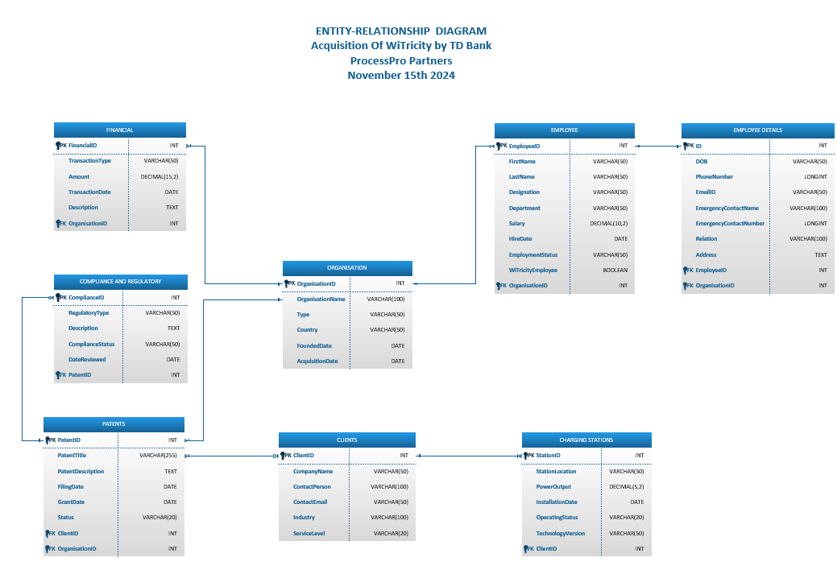
Database Design & Data Element Requirements
The goal of the database design is to provide a scalable, standardised and optimised framework to facilitate TD Bank's acquisition of WiTricity. Low redundancy, effective data retrieval and interoperability with current systems are the objectives.
Key Components:
Purpose of Tables
Primary key
Data elements
Interrelationship
Normalisation

Slide 32
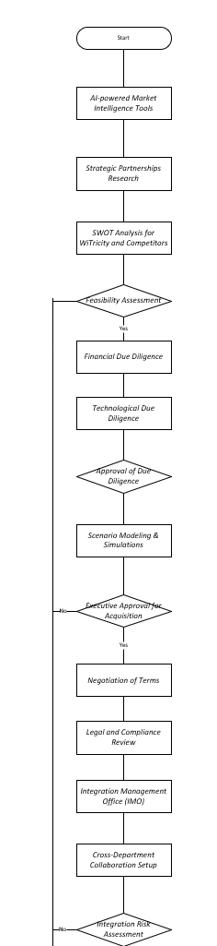
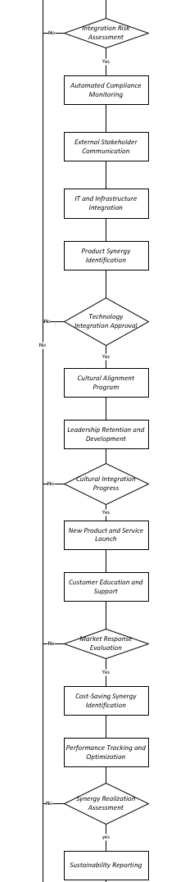
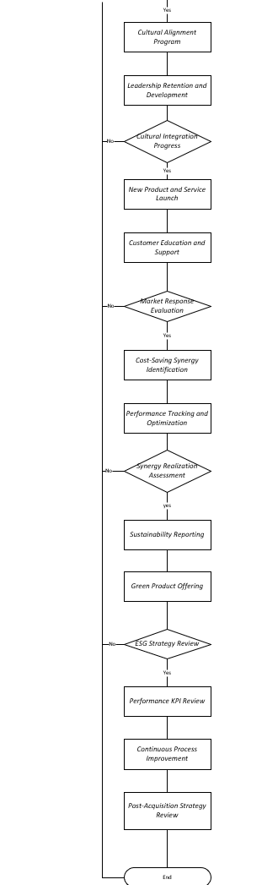
TO-BE Design
Operational Integration: Links WiTricity's charging infrastructure with TD Bank's customer and asset management systems that enables real-time data exchange.
Enhanced Analytics: Provides dashboards as well as reporting tools for performance metrics, compliance tracking and market insights.
Scalability: Ensures the system can adapt to future expansions such as integrating new technologies.
Risk Mitigation: Monitors regulatory compliance and intellectual property portfolios to prevent legal or operational risks.
Strategic Alignment: Aligns with TD Bank's goals of sustainability and leadership in EV markets, facilitating innovation as well as market penetration.

Slide 33
Transition Requirements
Strategic Alignment
Cultural Integration
Operational Integration
Legal and Regulatory Compliance
Customer Communication
Technology Integration
Financial and Budgetary Requirements
Branding and Marketing
Leadership and Governance
Timeline and Milestone

Slide 34
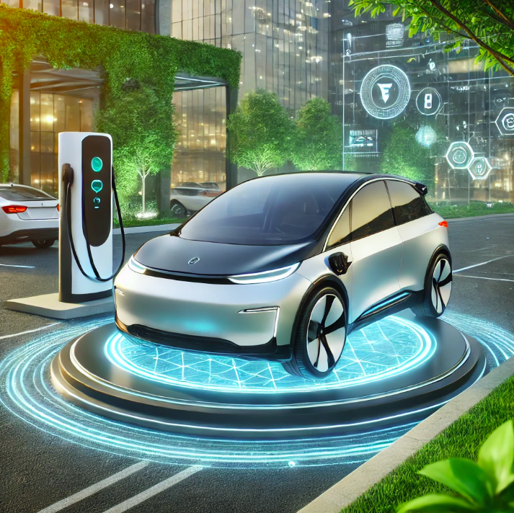
Conclusion
The strategic acquisition of WiTricity by TD Bank is a progressive step that supports the bank's mission to advance sustainability and technology. TD Bank is expanding its product line and establishing itself as a market leader in the quickly expanding electric vehicle sector by incorporating WiTricity's cutting-edge wireless EV charging technology into its portfolio.
The effective management of financial data, compliance, personnel resources and operational assets is supported by the well-structured database design. TD Bank's innovation capabilities are enhanced by utilising WiTricity's intellectual property and experience, while transition plans ensure smooth cultural as well as operational integration. This acquisition will reinforce TD's position in a competitive market, create new revenue streams and enhance its reputation as a leader in sustainable solutions.
34

Slide 35
Next Steps To Be Taken
Monitor and Adjust
Complete Integration Planning
Establish Governance Framework
Enhance Communication Strategies
Leverage Synergies
and Innovation
Finalise the roadmap for IT alignment, operational process standardisation and cultural integration.
Set clear milestones for each phase, from initial data migration to full operational integration.
Roll out a detailed communication plan for employees, customers and stakeholders.
Highlight benefits of the acquisition, addressing concerns and ensuring transparency.
Identify and capitalise on operational and technological synergies to drive efficiency as well as innovation.
Focus on expanding WiTricity’s R&D initiatives and aligning them with TD Bank’s goals.
Conduct regular progress reviews, assessing risks and challenges as they arise.
Adapt plans dynamically to maintain alignment with strategic objectives.
Form an integration task force with representatives from both TD Bank and WiTricity.
Define decision-making authority and conflict-resolution mechanisms to ensure smooth coordination.

Slide 36
News Board
Bank of Canada Cuts Policy Rate to 3.75%, Fourth Consecutive Reduction in 2024
Bank of Canada reduced its policy rate by 50 basis points to 3.75%, marking the fourth consecutive rate cut this year.
Inflation Rate Hits 2% in October 2024
Canada’s inflation rate unexpectedly rose to 2% in October, surpassing the forecasted 1.9%.
TD Bank Group Resolves AML Investigations
TD Bank Group has announced the resolution of investigations related to its anti-money laundering (AML) practices, marking an important milestone in the bank’s efforts to uphold compliance and integrity.
TD Bank Wins "Best Consumer Digital Bank in North America" for Fourth Year in a Row
TD Bank Group has been recognised as the "Best Consumer Digital Bank in North America" for the fourth consecutive year by Global Finance.
TD Bank Group has reported strong financial results for the fourth quarter and fiscal year 2024
The bank posted a 6% increase in net income, reaching $5.3 billion in Q4 and a 5% increase in fiscal 2024 net income to $21.2 billion. Total revenue for Q4 was $14.9 billion.

Slide 37
Call of Action - The Wireless Revolution: A Bold Step into the Green Economy
Acquiring WiTricity is more than a business decision. It is a bold step into the future of sustainability and innovation.
Why Act Now?
Secure Market Leadership: Gain a first-mover advantage in the wireless EV charging market.
Drive Sustainability: Align with global ESG goals and enhance TD Bank’s green finance reputation.
Unlock Growth: Tap into $469M+ in projected revenue over 20 years, driving exponential ROI.
Unparalleled Growth Potential
Market Trends: EV adoption expected to grow at a CAGR of 18% through 2030, with wireless charging leading at 30%+ CAGR.
Revenue Projection: $469M+ over the next 20 years.
ROI Trajectory:
Year 5–10: ROI reaches 114%.
Year 11–15: ROI grows to 275%.
Year 16–20: ROI peaks at 449%, solidifying TD Bank's market leadership.

Slide 38
Call of Action (Cont.)
Strategic Synergies
Revenue Streams: Licensing, infrastructure financing, and EV-specific loan products.
Technology Leadership: Proprietary magnetic resonance charging technology gives TD Bank a competitive edge.
Partnership Opportunities: Collaborations with automakers and fleet operators enhance scalability.
Next Steps
Leverage ProcessPro Partners' expertise for due diligence, integration, and innovation.
Drive TD Bank’s leadership in the electrified economy.
The Time is Now. Partner with ProcessPro Partners to lead this bold step toward sustainable growth.
Let’s make history together.

Slide 39
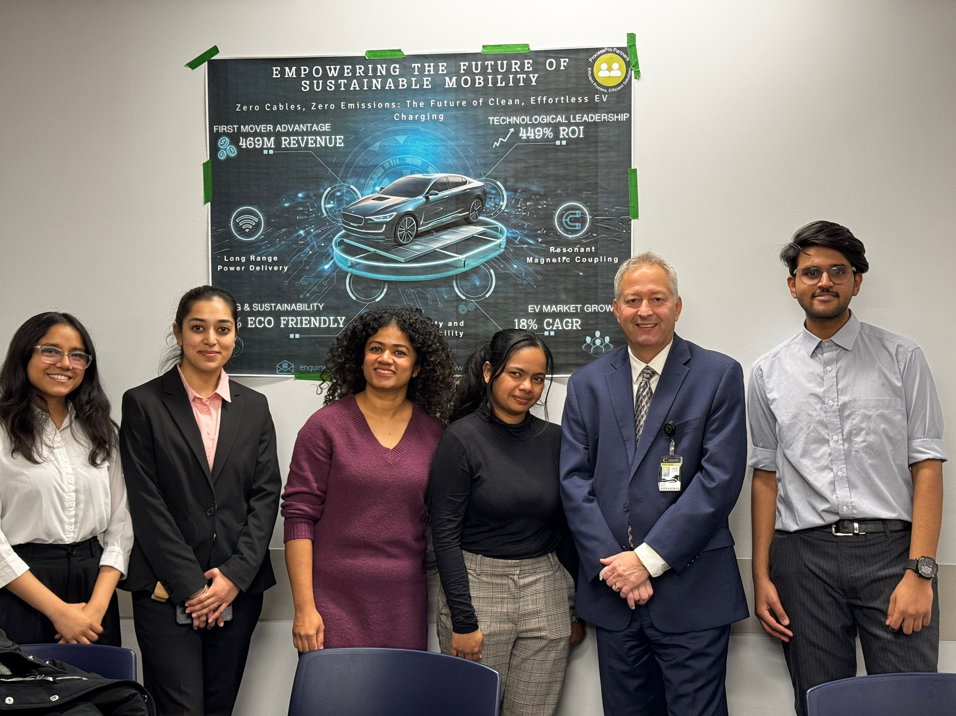



Contact Us
https://processpropartners.wixsite.com/processpropartners
+1 548 763 4375
Doon, Kitchener, ON, Canada

Slide 40
References
CTV News. (2024). Canadian inflation back at 2 per cent ahead of year-end interest rate decision.
https://www.ctvnews.ca/business/canada-s-inflation-rate-jumps-back-to-2-likely-curbing-large-rate-cut-bets-1.7114985
TD Bank. (2024, October 2). TD named Best Consumer Digital Bank in North America for fourth consecutive year by Global Finance.
https://td.mediaroom.com/2024-10-02-TD-named-Best-Consumer-Digital-Bank-in-North-America-for-fourth-consecutive-year-by-Global-Finance
TD Bank. (2024). TD Bank Group Reports Fourth Quarter and Fiscal 2024 Results
https://stories.td.com/ca/en/news/2024-12-05-td-bank-group-reports-fourth-quarter-and-fiscal-2024-results

Slide 41
THANK YOU

